Slide 1
Unit 1 Introduction

Slide 2
Introduction to algorithms
Algorithm is a systematic logical approach which is a well-defined, step-by-step procedure that allows a computer to solve a problem..
Pseudo code is a simpler version of a programming code in plain English which uses short phrases to write code for a program before it is implemented in a specific programming language.
A flowchart is a schematic representation of an algorithm or the diagrammatic representation of way to solve the given problem.

Slide 3
Algorithm
This is the first step to solve a mathematical or computer problem.
Breaking down the task.
“A sequence of activities to be processed for getting desired output from a given input.”
A computer program can be viewed as an elaborate algorithm.
While writing algorithms we will use following symbol for different operations:
‘+’ for Addition
‘-’ for Subtraction
‘*’ for Multiplication
‘/’ for Division and
‘←’ for assignment

Slide 4
Pseudo code
Pseudo code is an informal way of writing a program.
It is not exactly a computer program.
It represents the algorithm of the program in natural language and mathematical notations.
Usually, there is no particular code syntax to write a pseudo code.
Therefore, there is no strict syntax as a usual programming language.
It uses simple English language.

Slide 5
Flow chart
A Flow chart is a Graphical representation of an Algorithm.
Flowcharts are drawn using certain special purpose symbols such as Rectangles, Diamonds, Ovals and small circles.
These symbols are connected by arrows called flow lines.
Flow chart simply a diagrammatic /pictorial representation of way to solve the given problem.
Flowcharts can be used to describe all sorts of processes: business, educational, personal and of course algorithms.
So, flowcharts are often used as a program planning tool to visually organize step-by-step process of a program.

Slide 6
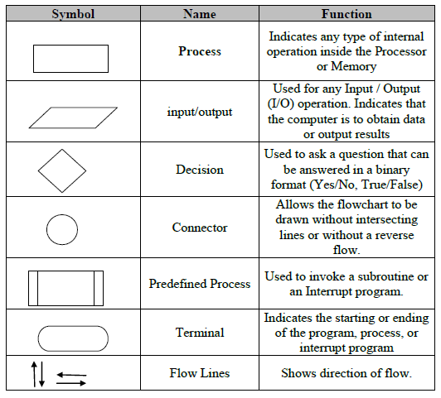
The following are the most common symbols used in drawing flowcharts:

Slide 7
Example1: Algorithm to add two numbers
Step 1: Start
Step 2: Read values num1 and num2.
Step 3: Add num1 and num2 and assign the result to sum.
sum←num1+num2
Step 4: Write/ Display sum
Step 5: Stop.

Slide 8
Example1: Pseudo code to add two numbers
Begin
Read: num1, num2;
Set sum = num1+num2;
Print sum;
End

Slide 9
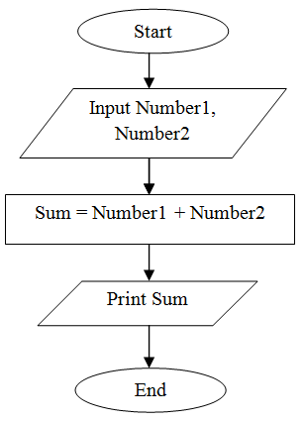
Example1: Flowchart to add two numbers

Slide 10
Example2: Algorithm to find the sum of individual digits of a given positive integer.
Step 1: start
Step 2: read a positive integer called num
Step 3: declare and initialize variables:
sum←0, dig←0
Step 4: repeat steps 4.1, 4.2, 4.3 until num greater than zero
4.1: dig ← num mod 10
4.2: sum ← sum + dig
4.3: num ← num/10
Step 5: write/ display sum
Step 6: stop

Slide 11
Example2: Pseudo code to find the sum of individual digits of a given positive integer
Begin
Read num;
Set sum=0, dig=0;
While num>0 then
dig = num % 10
sum = sum + dig
num = num/10
End while
print sum
End

Slide 12
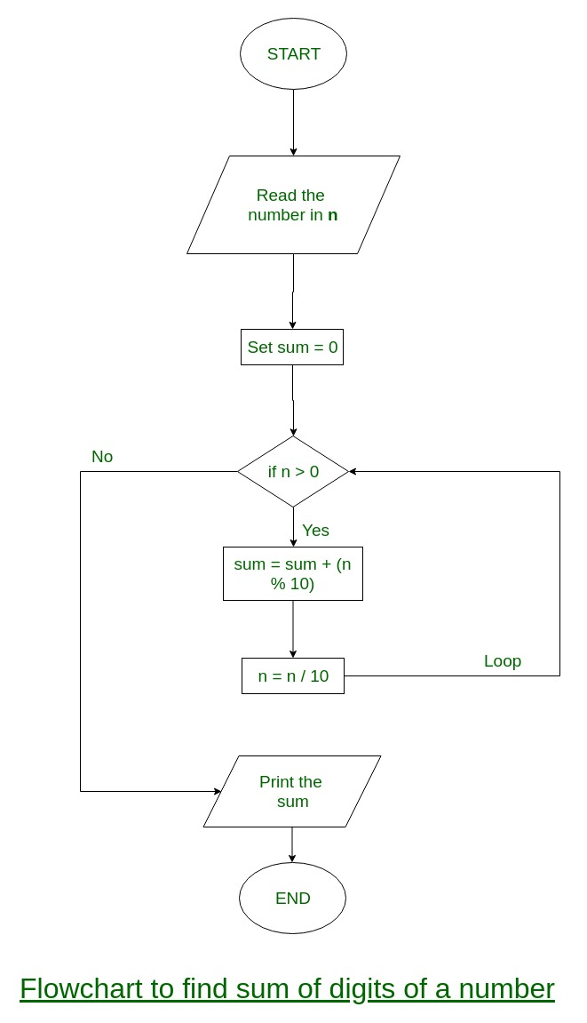
Example 2: Flow chart to find the sum of individual digits of a given positive integer

Slide 13
Example 3 : Algorithm to find the largest among two different numbers
Step 1: Start
Step 2: Declare variables a and b.
Step 3: Read values of a and b.
Step 4(a): If a greater than b then
Write/ Display a is the largest number.
Step 4(b): Else
Write/ Display b is the largest number.
Step 5: Stop

Slide 14
Example 3 : Pseudo Code to find the largest among two different numbers
Begin
Read a and b
if a>b then
Print a is largest
else
Print b is largest
end if
End

Slide 15
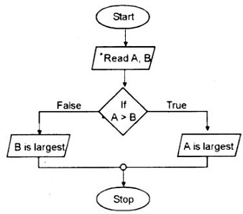
Example 3: Flow chart to find the largest among two different numbers

Slide 16
Example 4: Algorithm to convert temperature Fahrenheit to Celsius
Algorithm:
Step 1: Start
Step 2:Read Temperature in Fahrenheit F
Step 3: convert temperature to celsius
C← 5/9*(F-32)
Step 4: Print Temperature in Celsius: C
Step 5: Stop

Slide 17
Example 4: Pseudo code to convert temperature Fahrenheit to Celsius
Begin
Read Fahrenheit
set Celsius = 5/9*(Fahrenheit -32)
Print Celsius
End

Slide 18
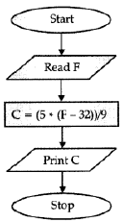
Example4: Flow chart to convert temperature Fahrenheit to Celsius

Slide 19
Introduction to C Language

Slide 20

History of C
Developed by Dennis Ritchie in the early 1970’s at Bell telephone laboratory.
C is a general purpose, structured programming language.
The first standard for C was published by ANSI (American National Standards Institute).

Slide 21
C Programming Language
Set of instructions is called as program.
These instructions are formed using certain symbols and words according to some rules known as syntax rules.
Purpose: C is used for systems programming (for writing OS) as well as for application programming (writing general purpose programs).

Slide 22
Features of C programming
C has many built-in functions that can be used to write any complex code or program.
C has its own built-in library. User defined functions can be added to extend library.
C has many data types and operators that helps in fast execution of program.
A program can be separated in different modules. Modularity makes a program easy to debug, test and maintain.
C language is case sensitive.

Slide 23
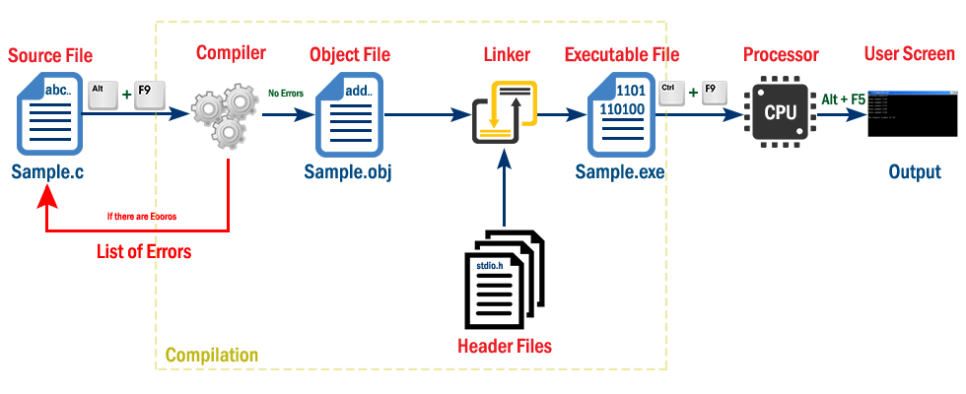
Program development steps (Creating, Compiling and running program)

Slide 24
Source code is a file with instructions in high level language.
A compiler translates the high level language into the machine language.
The Object code is the output of a compiler after it processes source code.
The Linker combines both the object code and specified header file code and generates an Executable file.
Loader is the program of the operating system which loads the executable file from the disk into the primary memory(RAM) for execution. It allocates the memory space to the executable module in main memory and then transfers control to the beginning instruction of the program
CPU places the result on User window.

Slide 25
Structure Of A C-program
This section is used to provide small description of the program. The comment lines are simply ignored by the compiler
/*comments or documentation*/
Preprocessing commands
or linking Section
Global declarations;
int main()
{
local declarations;
executable statements;
.
.
return 0;
}
Preprocessing commands are used to include header files and to define constants, it instructs the compiler to do required pre-processing before the actual compilation
Used to declare variables that are common to multiple functions
Every C program must write this statement. This statement (main) specifies the starting point of the C program execution
The return value of the main function is considered the "Exit Status" of the application.
On most operating systems returning 0 is a success status like saying "The program worked fine".

Slide 26
A simple C program to Print Hello world
#include<stdio.h>
void main()
{
printf("Hello, World! \n");
}
Output:
Hello, World!

Slide 27
C Tokens
• In a C program the smallest individual units known as C tokens.
• C has 6 types of tokens namely:
1) Keywords
2) Identifiers
3)Constants
4)String literals
5)Operators.
6) White spaces.

Slide 28
C Tokens
Keywords
These are reserved words of the C language.
There are 32 keywords in C, all the keywords are in small case.
auto double int struct
break else long switch
case enum register typedef
char extern return union
const float short unsigned
continue for signed void
default goto sizeof volatile
do if static while

Slide 29
Identifiers
An Identifier is a sequence of letters and digits, but must start with a letter. Identifiers are case sensitive. Identifiers specifies the names to the particular entity such as name of variables, functions etc.
Valid: Root, _getchar, __sin, x1, x2, x3, x_1, If
Invalid: 324, short, price$, My Name
Variable
Indicates the name of the data value.
Constants: It refers to fixed values that do not change during the execution of program.
Numeric constants: integer and real(float)
Character constants: single character and strings

Slide 30
String Literals
A sequence of characters enclosed in double quotes as “…”. For example “13” is a string literal and not number 13. ‘a’ and “a” are different.
Ex: “GfG”, “hello world” etc.,
Operators
Arithmetic operators like +, -, *, / ,% etc.
Logical operators like ||, &&, ! etc.
White Spaces
Spaces, new lines, tabs. These are used to separate the adjacent identifiers, keywords and constants.

Slide 31
Data types
Data type determines the type of data a variable will hold.
C language has some predefined set of data types to handle various kinds of data that we can use in our program.
Primary data types:
void: Has no values and no operations.
character(char): Used to store character value.
integer(int): Used to store whole numbers.
Floating point(float, double): Used to store real numbers.

Slide 32
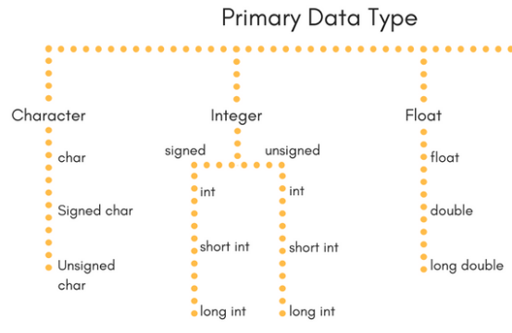

Slide 33
Data type
Type | Storage size | Value range | Format specifier
unsigned char | 1 byte | 0 to 255 | %c
signed char | 1 byte | -128 to 127 | %c
short int | 2 bytes | -32,768 to 32,767 | %d
unsigned short int | 2 bytes | 0 to 65,535 | %u
long int | 4 bytes | -2,147,483,648 to 2,147,483,647 | %ld
unsigned long int | 4 bytes | 0 to 4,294,967,295 | %lu
float | 4 bytes | 3.4*E-38 to 3.4*E+38 | %f
double | 8 bytes | 1.7*E-308 to 1.7*E+308 | %lf
long double | 10 bytes | 3.4*E-4932 to 1.1*E+4932 | %Lf

Slide 34
Derived and User defined data types
Derived data types are
array
pointer
User Defined Data types
structure
union
enum
typedef

Slide 35
Variables
We can store data in a memory space and name it, so that it becomes easier to access memory space.
The naming of an address is known as variable.
Unlike constant, variables are changeable, we can change value of a variable during execution of a program.
Rules to name a variable:
The name of a variable can be composed of letters, digits, and the underscore character.
Variable name must not start with a digit.
Blank spaces are not allowed in variable name.
Keywords are not allowed as variable name.
C is case-sensitive, so it is suggested to keep the variable names in lower case.
Example : average, height, age, total etc

Slide 36
Declaration of variables must be done before they are used in the program.
Syntax of variable declaration:
datatype variable;
Single variable declaration:
int a;
multiple variables declaration of same data type
float b, c;
Initializing a variable means to provide it with a value.
int a;
a = 10;
Or
int a=10;

Slide 37
Constants
A constant is a value or variable that can't be changed in the program, for example: 10, 20, 'a', 3.4, "c programming" etc.
Two ways to define constant in C:
const keyword: The const keyword is used to define constant in C programming.
Ex: const float PI=3.14;
#define preprocessor: The #define preprocessor is also used to define constant.

Slide 38
Example
#include<stdio.h>
int main(){
const float PI=3.14;
//PI=4.5; //it will render compile time error
printf("The value of PI is: %f",PI);
return 0;
}
Output:
The value of PI is: 3.14

Slide 39
Input & Output
The printf() and scanf() functions are used for input and output in C language.
Both functions are inbuilt library functions, defined in stdio.h (header file).
The printf() function is used for output. It prints the given statement to the console.
Syntax:
printf("format string",argument_list);
The format string can be %d (integer), %c (character), %s (string), %f (float) etc.
The scanf() function is used for input. It reads the input data from the console.
Syntax:
scanf("format string",argument_list);

Slide 40
Example
C program to take input from user and print
#include <stdio.h> //preprocessor directive command
int main()
{
int number;
// printf() dislpays the formatted output
printf("Enter an integer: ");
// scanf() reads the formatted input and stores them
scanf("%d", &number);
// printf() displays the formatted output
printf("You entered: %d", number);
return 0; // exit status
}
Output:
Enter a integer: 25
You entered: 25

Slide 41
C program to multiply two numbers
#include <stdio.h>
int main()
{
double firstNumber, secondNumber, product;
printf("Enter two numbers: ");
scanf("%lf %lf", &firstNumber,&secondNumber);
product = firstNumber * secondNumber;
printf("Product = %.2lf", product);
return 0;
}
Output:
Enter two numbers: 2.4
1.12
Product = 2.69

Slide 42
What is an Error?
It is an unexpected output
Illegal operation which results in abnormal working of the program.
It is also known as bug.
For the successful execution of the programs, it is necessary to remove all types of errors.
Debugging:
It is the process of finding and removing errors
from the program.

Slide 43
Types of Error
Syntax errors
Runtime errors
Logical errors

Slide 44
Syntax errors
Reason:
It occurs due to the violation of writing C syntax rules.
Detector:
Compiler detects during compilation.
Easy to locate and remove them
Compiler can easily specifies the location and type of error.
Outcome:
The program having syntax error cannot be compiled/translated.

Slide 45
When do syntax errors occurs?
Missing statement terminator(;).
Missing parenthesis({,}).
Misspelled Keyword.

Slide 46
Example
// C program to illustrate syntax error
#include<stdio.h>
void main()
{
int x = 10;
int y = 15;
printf("%d", (x, y)) // semicolon missed
}
Output:
error: expected ';' before '}' token

Slide 47
Runtime Error
Reason:
Occurs due to performing an illegal operation.
Detector:
Computer detects errors at the time of running the program.
Outcome:
Running program is stopped or crashed and a diagnostic message is displayed on screen causing that error

Slide 48
Why runtime error occurs?
Number when divided by zero
Accessing memory that is not available
These types of error are hard to find as the compiler doesn’t point to the line at which the error occurs.

Slide 49
Example
// C program to illustrate run-time error
#include<stdio.h>
void main()
{
int n = 9, div = 0;
// wrong logic number is divided by 0,
// so this program abnormally terminates
div = n/0;
printf("resut = %d", div);
}
Output:
warning: division by zero [-Wdiv-by-zero] div = n/0;

Slide 50
Logical error
Reason:
Occurs due to following a faulty algorithm.
provide incorrect output but appears to be error free
Detector:
Programmer find their errors by checking the whole program statement by statement.
Comparatively difficult to detect this error
Outcome:
Running program does not stop or crash but the wrong output is generated.

Slide 51
Example
Program to find modulus
#include<stdio.h>
int main()
{
int a=10,b=2;
int mod;
mod = a/b; // Logical Error. Correct statement “mod=a%b;”
return 0;
}
Output:
output which you were expecting will not be shown.

Slide 52
Operators in C
An operator is a symbol used to perform operations in a program.
Set of operators that are classified as follows...
Arithmetic Operators
Relational Operators
Logical Operators
Increment & Decrement Operators
Assignment Operators
Bitwise Operators
Conditional Operator
Special Operators

Slide 53
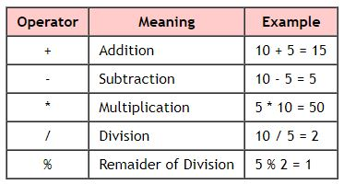
Arithmetic Operators
The addition operator can be used with numerical data types and character data type.
‘c’ + ‘r’ = ‘cr’
The remainder of division operator is used with integer data type only.

Slide 54
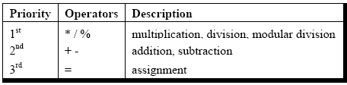
Priority of operators:
Ex:-
3 – 5 * 7 / 8 + 6 / 2
3 – 35 / 8 + 6 / 2
3 – 4 + 6 / 2
3 – 4 + 3
-1 + 3
2

Slide 55
Convert arithmetic statements to C
A x B – C x D
A * B – C * D
(M+N)(P-Q)
(M+N)*(P-Q)
3x2 + 5x + 2
3*x*x* + 5*x + 2
A+B+C
E+D
(A+B+C) / (D+E)

Slide 56
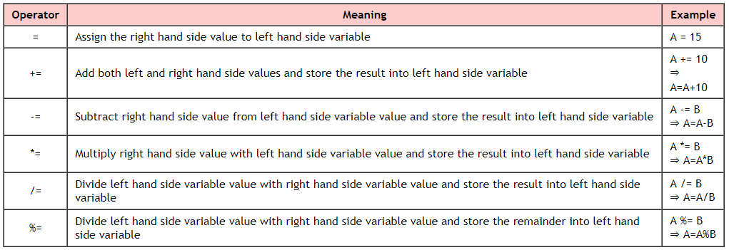
Assignment Operators
Assign right hand side value (Rvalue) to the left hand side variable (Lvalue).
The assignment operator is used in different variants along with arithmetic operators.

Slide 57
simple assignment operators short hand assignment operators
a=a+1 a+=1
a=a-1 a-=1
a=a%b a%=b
a=a*b a*=b
a=a/b a/=b

Slide 58
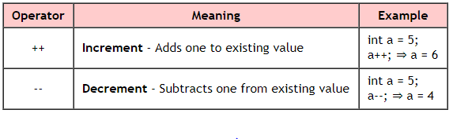
Increment & Decrement Operators
The increment and decrement operators are called as unary operators.
(++a): pre-increment
(--a): pre-decrement
(a--): post-decrement
(a++): post-increment

Slide 59
Pre-Increment and Pre-Decrement
Example:
#include <stdio.h>
void main()
{
int i = 5,j=5;
printf(“++i = %d, --j = %d",++i,--j);
}
Output:
++i = 6, --j = 4

Slide 60
Post-Increment or Post-Decrement
Example:
#include <stdio.h>
void main()
{
int i = 5,j=5;
printf("i++ = %d, j-- = %d\n",i++,j--);
printf(“i = %d, j = %d\n” ,i,j);
}
Output:
i++ = 5, j-- = 5
i = 6, j = 4

Slide 61
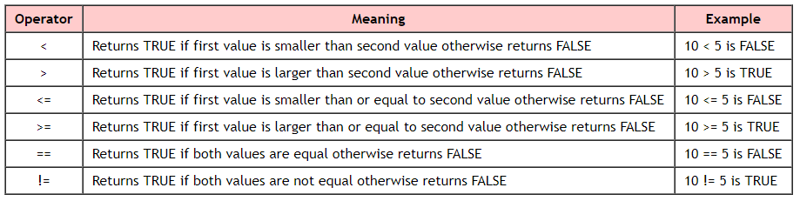
Relational Operators
They are used to compare or check the relationship between two values.
Every relational operator has two results TRUE or FALSE.
Relational operators are used to define conditions and take decisions in a program.

Slide 62
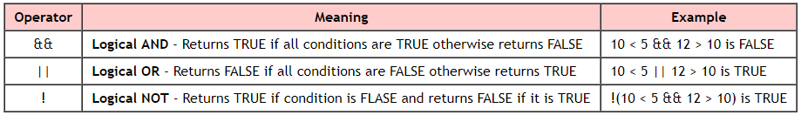
Logical Operators
The logical operators are used to combine multiple conditions into one condition.

Slide 63
exp-1 exp-2 exp-1 && exp-2 exp-1 || exp-2
non-zero non-zero 1 1
non-zero 0 0 1
0 non-zero 0 1
0 0 0 0
exp-1 !exp-1
non-zero zero
zero non-zero
Logical operator examples:
if ( marks >= 40 && attendance >= 75 )
grade = ‘P’;
if ( marks < 40 || attendance < 75 )
grade = ‘N’;

Slide 64
Conditional operator
It is also called as ternary operator .
This operator is used for decision making.
In this operator,
first we verify a condition
If the condition is TRUE the first option is performed,
if the condition is FALSE the second option is performed.
Syntax
Condition ? TRUE Part : FALSE Part ;
Example
A = (10<15) ? 100 : 200 ;
⇒ A value is 100

Slide 65

Program to find largest of 2 different numbers using ternary operator
#include<stdio.h>
main()
{
int i,j,large;
printf("Enter two numbers ");
scanf("%d %d",&i,&j);
large=(i>j)?i:j;
printf("Largest = %d",large);
}

Slide 66
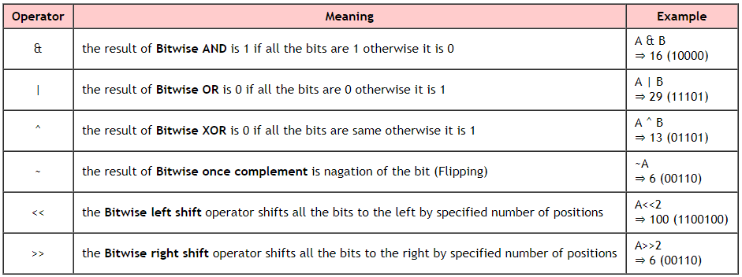
Bitwise Operators
Perform bit level operations.
The operations are performed based on the binary values.
For example: A = 25 (11001) and B = 20 (10100)

Slide 67
Special operators
sizeof operator
This operator is used to find the size of the memory (in bytes) allocated for a variable. This operator is used with the following syntax...
Syntax
sizeof(variableName);
Example
int A;
X=sizeof(A);
result is 2 if A is an integer

Slide 68
Comma operator (,)
This operator is used to separate variables while they are declaring, separate the expressions in function calls etc.
float a=2.5,b;
Pointer operator (*)
This operator is used to define pointer variables in c programming language.
int *p;
Dot operator (.)
This operator is used to access members of structure or union.
printf(“%d”, emp.num);

Slide 69
Expressions in C

Slide 70
What is an expression?
An expression is a collection of operators and operands that represents a specific value.
operator is a symbol which performs tasks like arithmetic operations, logical operations and conditional operations etc.,
Operands are the values on which the operators perform the task.
Here operand can be a direct value or variable or address of memory location.

Slide 71
The precedence and associativity of operators

Slide 72
Expression evaluation
In C programming language, expression is evaluated based on the operator precedence and associativity.
Expression Types in C
Infix Expression
Postfix Expression
Prefix Expression

Slide 73
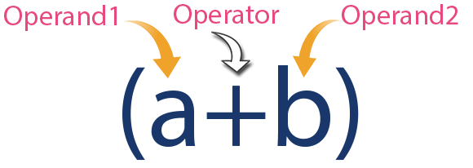
Infix Expression
The expression in which operator is used between operands is called as infix expression.
Structure of infix expression:
Example:
10 + 4 * 3 / 2
4 * 3 => 12
12 / 2 => 6
10 + 6 => 16

Slide 74
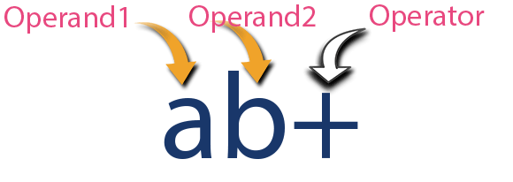
Postfix Expression
The expression in which operator is used after operands is called as postfix expression.
Structure of postfix expression:
Example:
4 5*8+
4*5 =>20
20+8 =>28

Slide 75
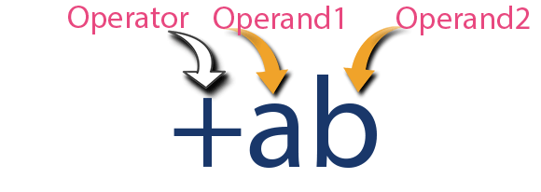
Prefix Expression
The expression in which operator is used before operands is called as prefix expression.
The structure of prefix notation:
Example:
+ * 2 3/ 10 2
2*3 => 6
10/2 =>5
6+5 =>11

Slide 76
Type conversion
Type Conversion: Conversion from one data type to another.
Two ways of type conversion are:
Implicit Type Conversion
Explicit Type Conversion

Slide 77
Implicit Type conversion
Also known as ‘automatic type conversion’.
Done by the compiler on its own, without any external trigger from the user.
All the variables are upgraded to the data type of the variable with largest data type. This is also known as type promotion.
bool -> char-> short int-> int -> unsigned int-> long-> unsigned long-> float -> double-> long double

Slide 78

Example program
#include<stdio.h>
void main()
{
char c='a';
int x=5;
x = x+c; //char is converted to int
float y=6.45;
y = y+x; //int is converted to float
printf("x=%d\n",x);
printf("y=%.2f\n",y);
}

Slide 79
Explicit Type Conversion
This process is also called type casting and is user defined.
Here the user can type cast the result to make it of a particular data type.
The syntax in C:
(type) expression
Type indicated the data type to which the final result is converted.

Slide 80

Example program
#include<stdio.h>
void main()
{
int a=8;
float b=a/3;
printf("8/3 = %f\n",b);
b=(float)a/3;
printf("8/3 = %.2f",b);
}

Slide 81
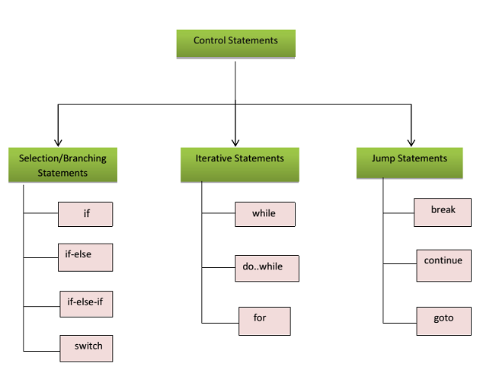
Control Statements

Slide 82
Conditional Statements
In c program, statements are executed sequentially, when no options or repetitions are necessary.
But the order of execution changes based on
certain conditions
repeats group of statements until certain condition is met
This involves decision making to check whether a conditions has occurred or not.
Then direct the computer to execute some statements accordingly.
Such decision making statements in C:
if statement
switch statement
Conditional operator statement

Slide 83
if statement in c
In c, if statement is used to make decisions based on a condition.
The if statement verifies the given condition and decides whether a block of statements are executed or not based on the condition result.
The if statement may be implemented in different forms depending on the complexity of conditions to be tested. The different forms are:
Simple if statement
if - else statement
Nested if - else statement
else if ladder(if-else-if statement )

Slide 84
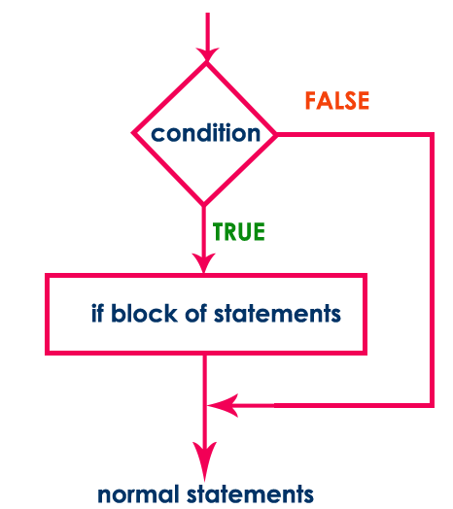
Simple if statement
Syntax:
if (condition)
{
block of statement;
}
statement-x;
The simple if statement evaluates specified condition.
If condition is TRUE (non-zero), the block of statements are executed and then statement-x is executed
otherwise the block of statements are skipped and the execution will jump to statement-x.
Simple if statement is used when we have only one option that is executed or skipped based on a condition.

Slide 85
Example: C program to find whether given number is divisible by 5
#include <stdio.h>
void main()
{
int n ;
printf("Enter any integer: ") ;
scanf("%d", &n) ;
if ( n%5 == 0 )
printf("%d is divisible by 5\n“, n) ;
printf("statement does not belong to if!!!") ;
}
Case 1:
Enter any integer: 100 100 is divisible by 5 statement does not belong to if!!!
Case 2:
Enter any integer: 99 statement does not belong to if!!!

Slide 86
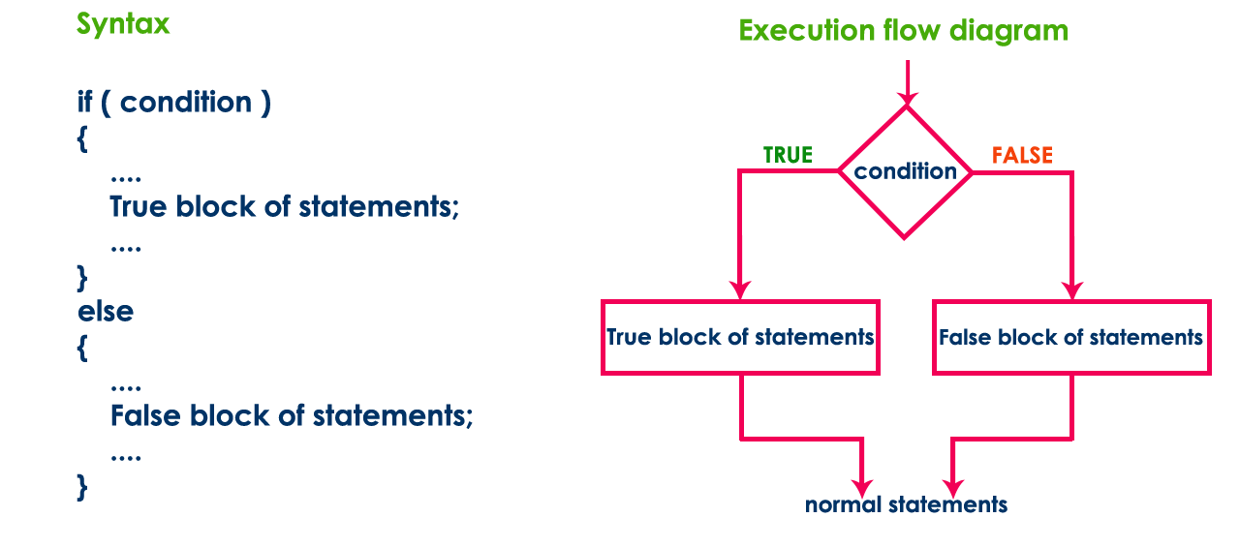
if - else statement
The if-else statement is an extension of the simple if statement.
Syntax:
if(condition)
{
true block statements;
}
else
{
false block statements;
}
In either case, either true block or false block will be executed, not both.

Slide 87
Example: c program to check whether given number is even or odd
#include <stdio.h>
#include<conio.h>
void main()
{
int n ;
printf("Enter any integer: ") ;
scanf("%d", &n) ;
if ( n%2 == 0 )
printf("%d is EVEN\n", n) ;
else
printf("%d is ODD\n", n) ;
}
Case 1:
Enter any integer: 100 100 is EVEN
Case 2:
Enter any integer: 99 99 is ODD

Slide 88
Nested if-else statement
When a series of decisions are involved, we use more than one if-else statement in nested form.
The nested if-else statement can be defined using any combination of simple if and if-else statements.
Syntax:
if (condition-1)
{
if (condition-2)
{
statements 1;
}
else
{
statements 2;
}
}
else
{
statements 3;
}
statement x;

Slide 89
Example: c program to check whether given number is even or odd if it is below 100.
#include <stdio.h>
void main(){
int n ;
printf("Enter any integer: ") ;
scanf("%d", &n) ;
if ( n < 100 ) {
printf(“%d is below 100\n", n) ;
if( n%2 == 0)
printf("And it is EVEN") ;
else
printf("And it is ODD") ;
}
else
printf(“%d is not below 100" , n);
}
Case 1:
Enter any integer: 55 55 is below 100 And it is ODD
Case 2:
Enter any integer: 999 999 is not below 100

Slide 90
else if ladder(if-else-if statement )
When multi path decisions are involved, we use a chain of ifs in which the statement associated with each else is an if.
Syntax:
if (condition 1)
statement 1;
else if(condition 2)
statement 2;
else if(condition 3)
statement 3;
else
statement 4;
statement x;

Slide 91
Example: C program to find the largest of three numbers.
#include <stdio.h>
void main(){
int a, b, c ;
printf("Enter any three integer numbers: ") ;
scanf("%d%d%d", &a, &b, &c) ;
if( a>=b && a>=c)
printf("%d is the largest number", a) ;
else if (b>=a && b>=c)
printf("%d is the largest number", b) ;
else
printf("%d is the largest number", c) ;
}
Output:
Enter any three integer numbers: 55 60 20 60 is the largest number

Slide 92
When we use conditional control statement like if statement, condition might be an expression evaluated to a numerical value, a variable or a direct numerical value.
If the expression value or direct value is zero the condition becomes FALSE otherwise becomes TRUE.
Examples:
if(10) - is TRUE
if(x) - is FALSE if x value is zero otherwise TRUE
if(a+b) - is FALSE if a+b value is zero otherwise TRUE
if(a = 99) - is TRUE because a value is non-zero
if(10, 5, 0) - is FALSE because it considers last value
if(0) - is FALSE
if (a=0, x=10) – is TRUE because it considers last value
if(a=10, b=15, c=0) - is FALSE because last value is zero

Slide 93
switch statement in C
When one of the many options is to be selected, we can use if statement to control the selection.
The complexity increase with increase in number of options.
Program becomes difficult to read and flow.
C has a built-in multi-way decision statement known as switch.
The switch statement tests the value of a given (or expression) against a list of case values
And when match is found, a block of statements associated with that case is executed.
The value of the 'expression' in a switch-case statement must be an integer, char, short, long.

Slide 94
expression can integer or character.
value1, value2 ... are constants (unique) or constant expressions and are known as case labels.
block1, block2 ... are statement lists and may contain zero or more statements.
No need of braces for blocks and case labels end with colon (:).
If a case is found whose value matches with the value of the expression, then the block of statements that follows the case are executed.
The break statement signals the end of a particular case and causes an exit from switch.
The default is an optional case.
Syntax:
switch (expression)
{
case value1:
block1
break;
case value2:
block2
break;
.........
.........
default:
default block
break;
}
Statement-x;

Slide 95
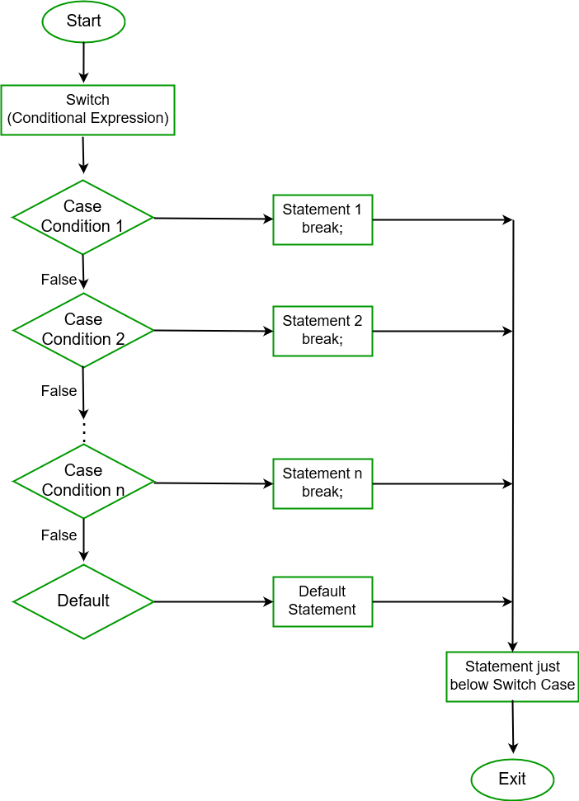
Flow of execution

Slide 96
Example: c program to assign grades.
#include <stdio.h>
void main(){
int n ;
printf("Enter CGPA: ") ;
scanf("%d", &n) ;
index = n/10
switch( n ) {
case 10:
case 9:
case 8: printf("Distinction") ;
break ;
case 7:
case 6: printf("First division") ;
break ;
case 5: printf("Second division") ;
break ;
case 4: printf("Third division") ;
break ;
default: printf("Fail") ;
}
}
Case 1:
Enter marks: 85 Distinction
Case 2:
Enter marks: 15 Fail

Slide 97
The conditional operator
Conditional operator is useful for making two-way decisions.
This operator is a combination of ? and :, and takes 3 operands.
Syntax:
conditional expression ? expression1 : expression2
The conditional expression is evaluated first.
If the result is non-zero, expression 1 is evaluated and its value is returned.
Otherwise expression 2 is evaluated and its value is returned.
For example:
if (x%2==0)
flag=1
else
flag=0
Can be written as
flag = (x%2==0) ? 1 : 0
Using conditional operator is concise and efficient

Slide 98
The conditional operator can be nested for evaluating more complex assignment decisions.
Example: consider the weekly salary of a sales girl who is selling some domestic products. If x is the number of products sold in a week, her weekly salary is given as:
4x +100 for x < 40
salary= 300 for x=40
4.5x+150 for x>40
Using else-if ladder
if(x<40)
salary = 4*x + 100
else if (x>40)
salary = 4.5*x + 150
else
salary = 300
This equation can be written as
salary = (x != 40) ? ((x<40) ? (4*x + 100) : (4.5*x + 150)) : 300

Slide 99
Loops
Loops are used to repeat a set of statements.
In looping, a sequence of statements are repeatedly executed until some end condition is met.
A program loop has
Body of the loop.
Control statement.
Depending on the position of the control statement in the loop, control structure has
Entry controlled loop.
Exit controlled loop.

Slide 100
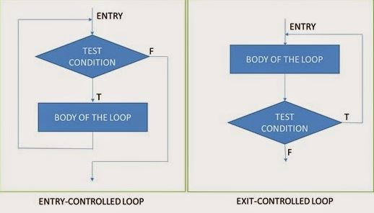
Entry controlled and exit controlled loop structure is shown below:
There are three loops in C programming:
while loop
do...while loop
for loop

Slide 101
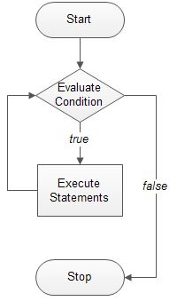
while loop
while loop is a control flow statement that allows code to be executed repeatedly based on a given Boolean condition.
The Boolean condition is either true or false.
The syntax of a while loop is:
Initialization;
while (test expression)
{
body of the loop;
increment/decrement;
}
where, the test expression is the condition that checks it is true or false before each iteration.
while is an entry controlled loop.

Slide 102
Example #1: while loop
// Program to print a statement 5 times using while loop
#include <stdio.h>
int main ()
{
int a = 1;
while( a < =5 )
{
printf(“hello world \n");
a++;
}
return 0;
}
Output: hello world
hello world
hello world
hello world
hello world

Slide 103
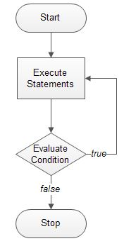
do….while loop
The body of do...while loop is executed first and then the test expression is evaluated.
If condition is true then loop is iterated till the condition is satisfied.
The body of the do...while loop is executed at least once even if the condition is false.
do...while loop Syntax
Initialization;
do
{
body of the loop;
increment/decrement;
}
while (test expression);
Do-while loops are sometimes useful if you want the code to output some sort of menu to a screen so that the menu is guaranteed to show once.

Slide 104
Example #2: do.....while loop
// Program to print numbers from 10 to 1 using do…while loop
#include <stdio.h>
void main()
{
int i = 10;
do
{
printf(" %d\n", i );
i --;
}
while ( i > 0 );
}
output:
10
9
8
7
6
5
4
3
2
1

Slide 105
The for statement
The for loop is entry-controlled loop.
It is concise control structure.
General form of for:
for( initialization; test-condition; increment)
{
body of the loop
}
Control variable is incremented
Initialization of control variables
The value of control variables is tested

Slide 106
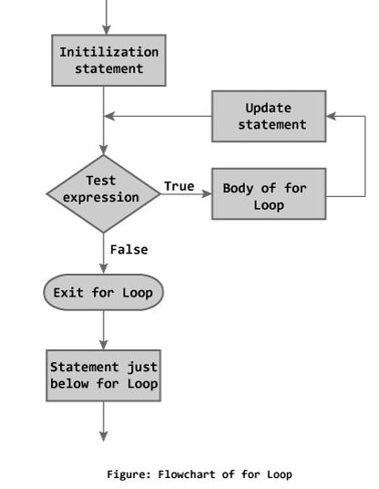
Flow chart

Slide 107
Example
#include<stdio.h>
void main()
{
int i;
for ( i=1; i<=10; i++)
{
printf(“%d”,i);
}
printf(“\nEnd of for loop.\n”);
}
Output:
12345678910
End of for loop.
#include<stdio.h>
void main()
{
int i;
for ( i=10; i>0; i--)
printf(“%d”,i);
printf(“\nEnd of for loop.\n”);
}
Output:
10987654321
End of for loop.

Slide 108
Program to print Fibonacci series
#include<stdio.h>
void main()
{
int num1=0, num2=1, fib ,n ,I;
printf(“\nEnter the value of n: ”);
scanf(“%d”,&n);
if(n==1)
printf(“Fibonacci series: %d ”, num1)
if(n>=2)
printf(“Fibonacci series: %d %d ”, num1,num2);
for(i=3; i<=n; i++)
{
fib=num1+num2;
printf(“%d ”,fib);
num1=num2;
num2=fib;
}
}
Output:
Enter the value of n: 8
Fibonacci series: 0 1 1 2 3 5 8 13

Slide 109
More than one variable can be initialized and the increment section may have more than 1 part.
#include<stdio.h>
void main()
{
int n,m,p;
for(n=1, m=5; n<=m; n++, m--)
{
p = m/n;
printf(“%d / %d =%d\n”, m,n,p);
}
}
Output:
5 / 1 = 5
4 / 2 = 2
3 / 3 = 1

Slide 110
Test condition may have any compound relation.
sum=0;
for (i=1; i<5 && sum<50; i++)
{
sum=sum+i;
printf(“%d %d\n”, i, sum);
}
Use of expressions in initialization and increment.
for(x = (m+n)/2 ; x>0 ; x = x/2)
Initialization, loop-continuation, and increment can contain arithmetic expressions. If x equals 2 and y equals 10
for ( j = x; j <= 4 * x * y; j += y / x )
is equivalent to
for ( j = 2; j <= 80; j += 5 )

Slide 111
Both the initialization and increment sections are omitted in the for statement.
m=10;
for( ; m!=100 ; )
{
printf(“%d\n”,n);
m=m+10;
}
If the loop continuation condition is initially false
The body of the for structure is not performed
Control proceeds with the next statement after the for structure

Slide 112
Nested for loop
for(n=1;n<=10;n++)
{
--------
--------
for(j=1;j!=5;j++)
{
--------
--------
}
------
------
}
Inner loop
outer loop

Slide 113
Program to find the prime numbers from 2 to 10
#include <stdio.h>
int main () {
int i, j;
for(i = 2; i<10; i++)
{
for(j = 2; j <= (i/j); j++)
if(!(i%j))
break;
if(j > (i/j))
printf("%d is prime\n", i);
}
return 0;
}
Output:
2 is prime
3 is prime
5 is prime
7 is prime

Slide 114
Jump Statements
break
When a break statement is encountered, it terminates the block and gets the control out of the switch or loop.
The break statement can be used in both switch and loop statements.
A break causes the innermost enclosing loop or switch to be exited immediately.

Slide 115
Example that illustrates break
//Program to print 20 natural numbers and exit the loop at 10.
#include<stdio.h>
int main()
{
int i=1;
while ( i <20 )
{
if ( i == 10)
break;
printf(“%d\n”,i);
i++;
}
return 0;
}
Output:
1
2
3
4
5
6
7
8
9

Slide 116
continue
Skips the remaining statements in the body of a while, for or do/while structure
Proceeds with the next iteration of the loop
while and do/while
Loop-continuation test is evaluated immediately after the continue statement is executed
for
Increment expression is executed, then the loop-continuation test is evaluated

Slide 117
Example program for continue
#include<stdio.h>
void main()
{
int i;
for(i=1;i<=10;i++)
{
if(i==5)
continue;
printf("%d\n",i);
}
}
Output =
1
2
3
4
6
7
8
9
10

Slide 118
The goto statement
In c, there are control statements which does not need any condition to control the program execution flow.
When we use goto statement in the program, the execution control directly jumps to the line with specified label unconditionally..
Using goto statement we can jump from top to bottom or bottom to top.
Syntax
goto label;
Statement x;
------
label:
Statements 1;
Statements 2;
The goto statement can be used with any statement like if, switch, while, do-while and for etc,.
label:
statetements;
-----------
-----------
goto label;

Slide 119
Example: forward jump
#include <stdio.h>
void main()
{
printf("We are at first printf statement!!!\n") ;
goto last ;
printf("We are at second printf statement!!!\n") ;
printf("We are at third printf statement!!!\n") ;
last:
printf("We are at last printf statement!!!\n") ;
}
Output
We are at first printf statement!!!
We are at last printf statement!!!

Slide 120
Example: backward jump
#include<stdio.h>
Void main()
{
double x,y;
read:
scanf(“%f”, &x);
y = sqrt(x);
print(“%f %f\n”, x , y);
goto read;
}
#include<stdio.h>
Void main()
{
double x,y;
read:
if ( x > 0)
{
scanf(“%f”, &x);
y = sqrt(x);
print(“%f %f\n”, x , y);
goto read;
}
}

